Slide 1
Capital Investment Network
Update on hub Programme
2nd May 2017
Presented by
David MacDonald, National hub Programme Director
Scottish Futures Trust

Slide 2
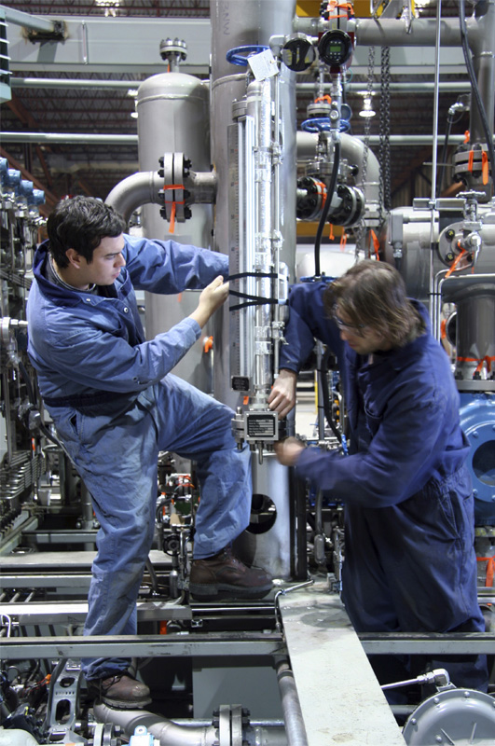
Presentation agenda
Introduction
Overview of hub status
Key features of 2016-17
Post-ESA10 outcomes
Strategic proposals for hub
Presentation summary

Slide 3
Overview of hub status

Slide 4
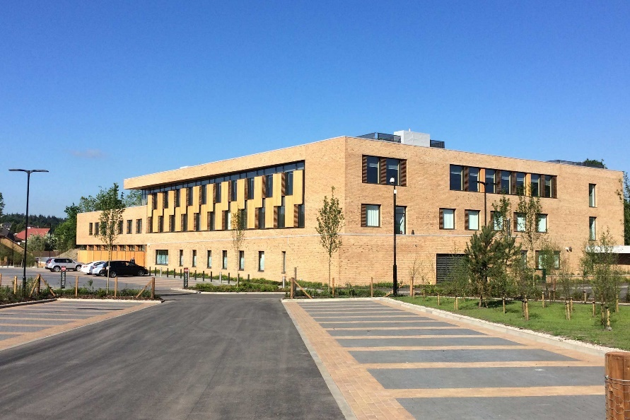
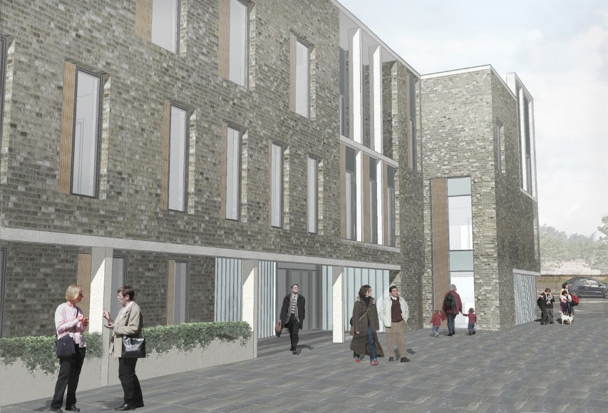
Key features of 2016-17
8 – nr of hub DBFM projects to reach financial close
39 – nr of new projects started on site
£360m – capital value of new hub projects handed over
9,288 – nr of construction jobs supported by the hub programme
79% - proportion of contracts awarded to SMEs in the hub programme
The on-line community infrastructure database was launched in March 2017

Slide 5
Post-ESA10 outcomes
Compliant hub DBFM structure
Funding within the hub Charitable Foundation
Delayed projects now progressing through construction
Mobilisation for operational readiness
Demonstration of added hub value through tangible outcomes

Slide 6
Strategic proposals for hub
Technical matters
Paymech; PBAs; BIM; whole life value; Cole report
Delivery
Efficiency in development; quality of output; performance measurement
Collaboration
Alignment of service models; co-location; integrated outcomes
Step-change
Development partnership; SFT workstreams; sustaining the programme through innovation
Service
Alignment
Co-location
Solution
Strategic
Objective-led
Outcome
Effective
Efficient

Slide 7
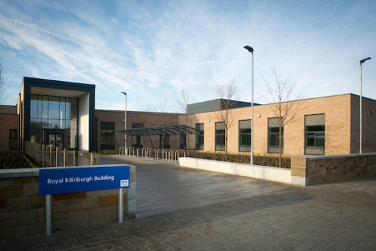
Presentation summary
Celebration of success
Building on tangible outcomes
Process improvement
Cultural change
Realising the potential of the hub programme

Slide 8
World class infrastructure for
the people of Scotland

